Slide 1
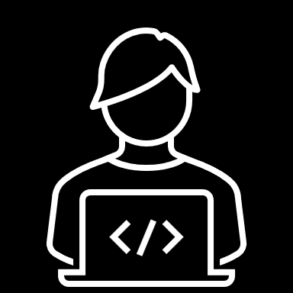
TEAM
RIGHT BROTHERS
Asadujaman Nur
Miguel Rodriguez
Hammad Karamat
RAVEN
ROBOT CONTROL WITH DDS AND TCP/IP

Slide 2
PREVIEW
RAVEN
METHODS
DDS
TCP/IP
CLOUD DATA TRANSFER
APPROACH
INITIAL RESULT

Slide 3
DATA DISTRIBUTION SYSTEM
RAVEN
Features
Middleware Machine to Machine
Domain
Publisher
Subscriber
Topic

Slide 4
Data Distribution System
INTERCONNECTION
Simplify network programming
Publish – subscribe pattern
A node can publish, subscribe or do both at the same time
Little design time for interactions
DDS handle message delivery without the intervention of the user application including:
Determining the receiver
Where the receiver is located
What happens in the message is not delivered

Slide 5
SCENARIO
Data Distribution System
Basic connectivity to network using Internet Protocol (IP).
Discovery of publishers and subscribers.
Quality of service (QoS) Compatibility between requester and offerer.
Delay-tolerant networking.
Multiple topics and instances of topics.
Exclusive ownerships of topics.
Content filtering of topic data including time and geographic.

Slide 6
TCP/IP
RAVEN
All About Layers
Application
Transport
Internet
Network

Slide 7
TCP/IP
CLIENT
A client can be a
  Machine
    Laptop
    Mobile phone
    Tablet
    Desktop
  Program
    Web browser
    Word
    Photoshop

Slide 8
TCP/IP
SERVER
A server is a computer program NOT a device
  High performance machines are called servers because they run SERVER programs
  Servers provide functionalities and serve other programs.
A single server can server multiple clients
A server should run 24-7
A single machine can run multiple servers (virtual servers)
A server listen for requests and respond with a message

Slide 9
Data Uploading To
THE CLOUD
Uploading data to cloud using things speak from server
Data analysis
Using API to upload data to website
Personalized frontend website for the data received
Personalized communication with data
Applications

Slide 10
RAVEN
APPROACH
The robot OS is based on ROS2 running on Ubuntu server
Ubuntu server does not provide a graphical interface
The server is running on the computer
The robot is running a client that will send the information to the server using TCP/IP

Slide 11
RAVEN
INITIAL RESULTS
A first test was made using ROS_DOMAIN.
Using this method, we can send the information of the LiDAR if the robot is connected to the same router than the computer

Slide 12
Q&A
THANK YOU FOR LISTENING

